Slide 1
Microsoft Power BI Engineering
Human Resources Analytics Dashboard
Instructor: Eng. Ahmed Megahed
Amal Maher Hader Mustafa
Bassant El-Mokaddem Heba Ahmed
Esraa Adel Huda Azzam

Slide 2
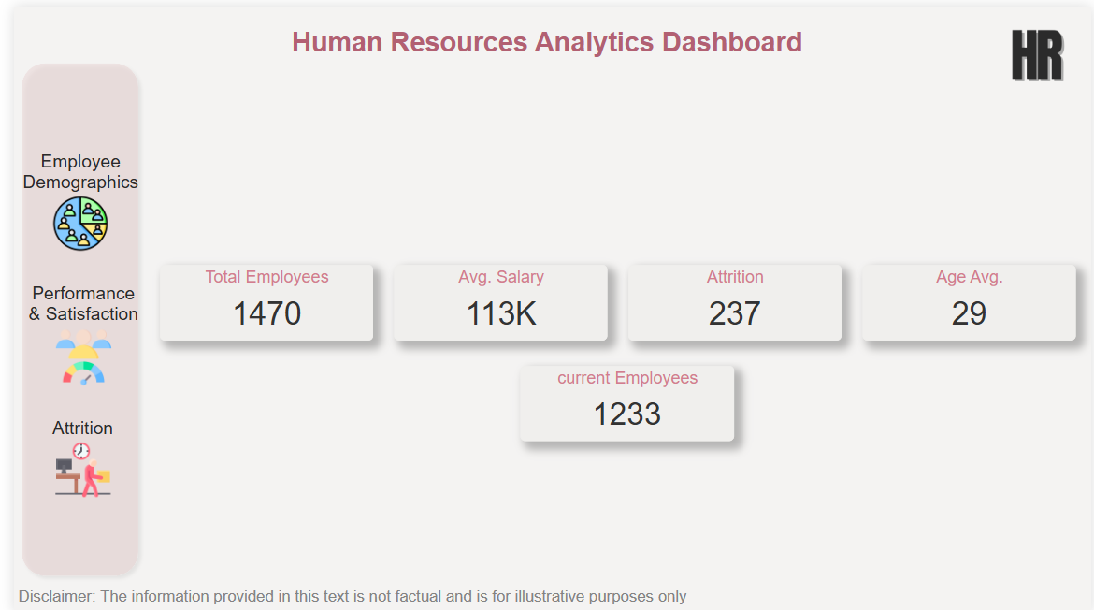

Slide 3
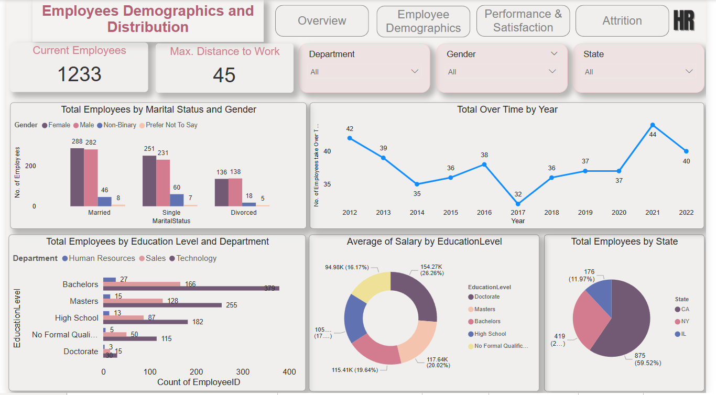

Slide 4
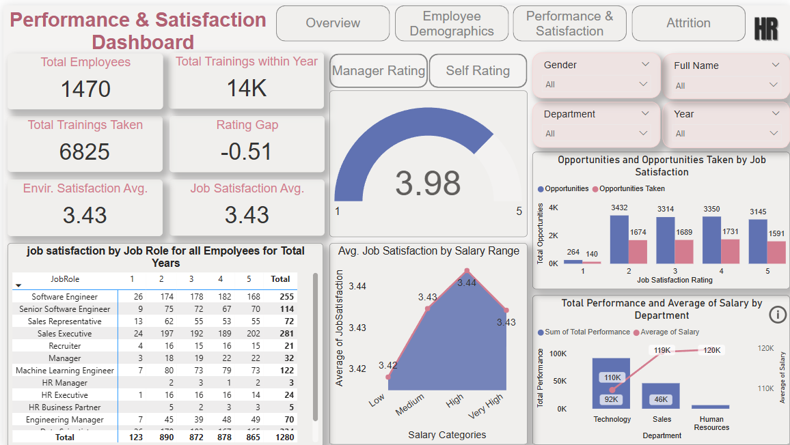

Slide 5
